Slide 1
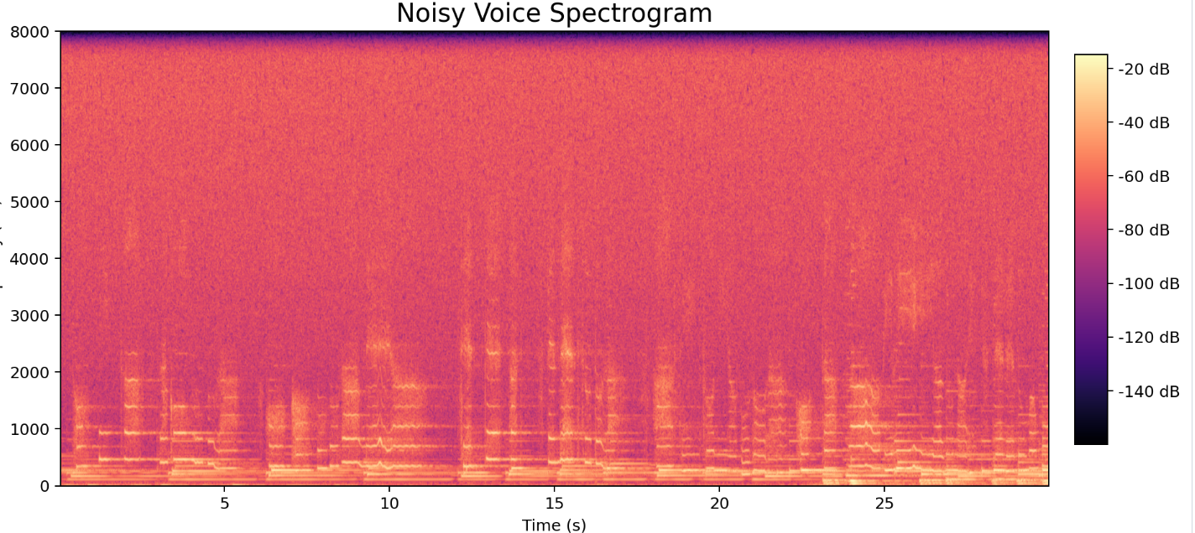
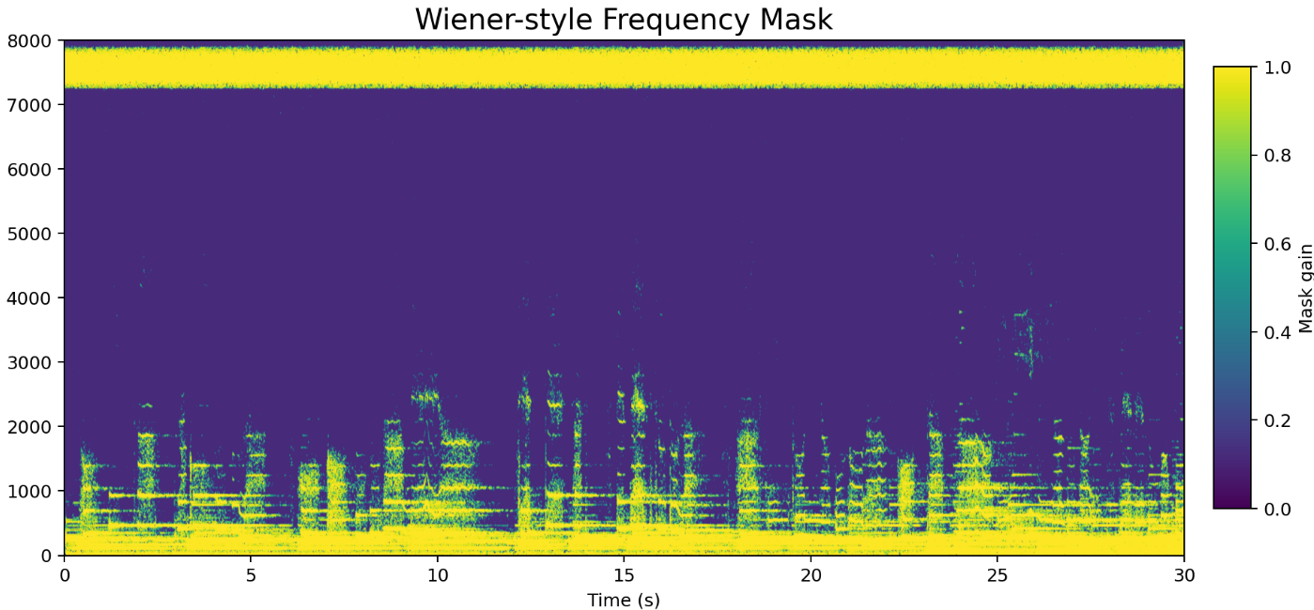


Silence in the Spectrum: Unmasking Speech From Noise
Junze Xie | Ming Chen | Zifan Xu | Yimin Chen | Wanting Luo
Signals, Systems & Probability

Slide 2
Table of contents
01
2
Background & Problems
02
Signal Model & Baseline Filter
Advancing:
Wiener Masking
Results & Evaluation
03
04

Slide 3
01
Background & Problems
Voice Denoising in
Physical Environment

Slide 4
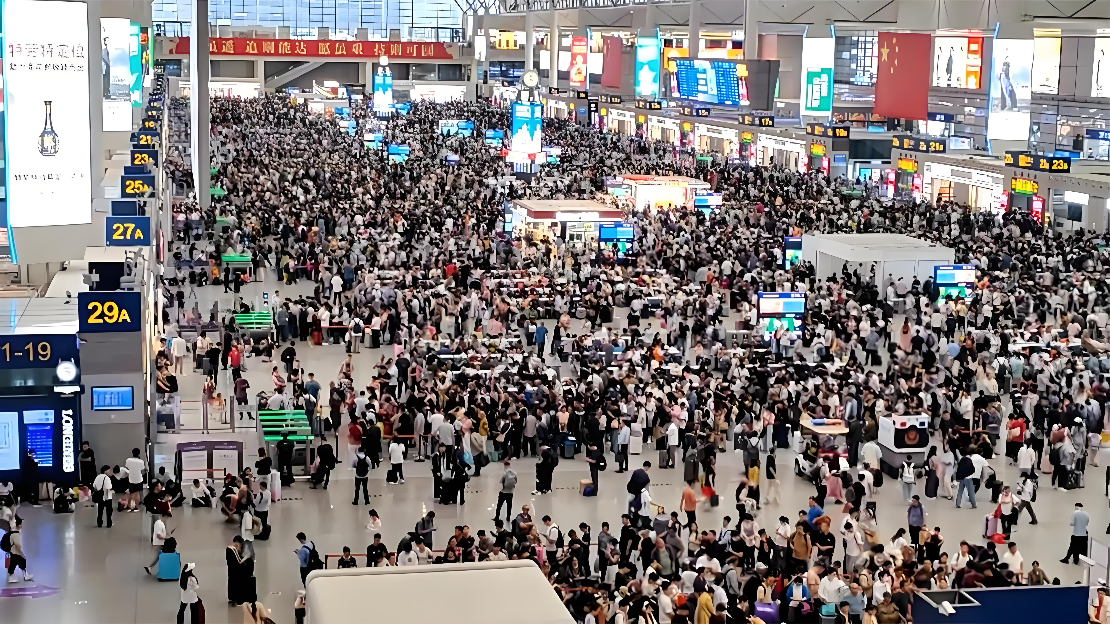
Scenario
4
In a public setting
Such as a train station
A phone call came through

Slide 5

Scope
A voice signal affected by high-frequency hiss in public environment.
simulated signal
Physical signal

Slide 6
Problem Statement
6
Clean Voice
Noisy Voice
Denoising System
Enhanced Voice
Hiss Noise
Goal: remove the noise from background and preserve the voice from user.

Slide 7
02
Signal Model & Baseline Filter
Fundamentals of Speech Denoising

Slide 8
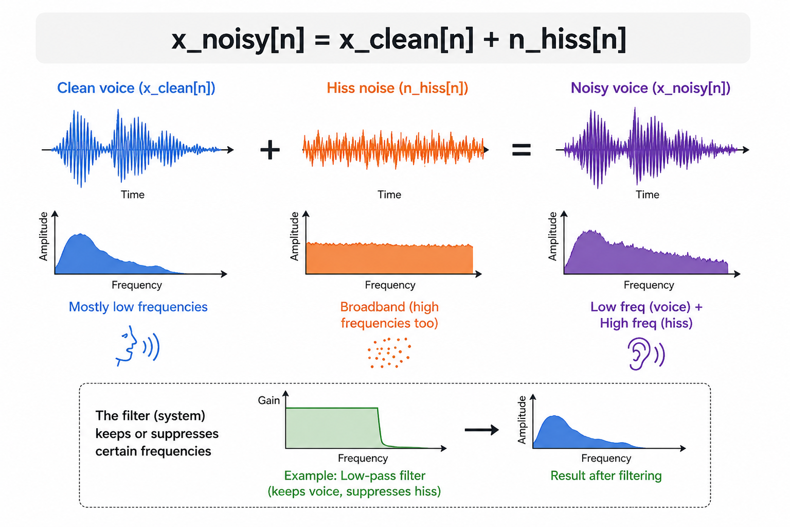
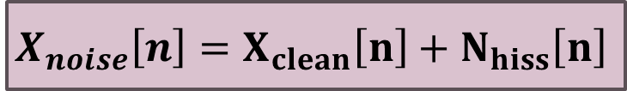
Signal Model
8
$$X_{noise}\left[n\right]=X_{clean}\left[n\right]+N_{hiss}\left[n\right]$$
—
The clean and hiss voise are both signals.
—
The noisy voice is a
superposition.
—
The filter is an
input-output system.
Frequency response illustrates what the system keeps or suppresses.

Slide 9
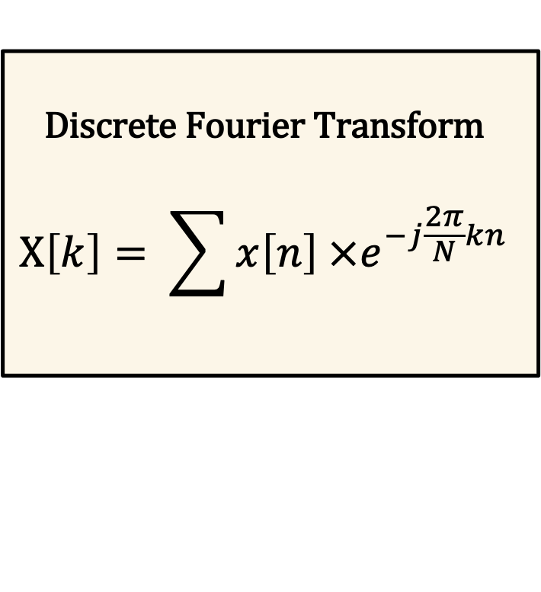
Frequency-Domain Observation
9
Discrete Fourier Transform
$$X\left[k\right]= \sum{x\left[n\right] ×e^{−j\frac{2π}{N}kn}}$$
Low Frequency
Clean Voice
High Frequency
Hiss Noise

Slide 10
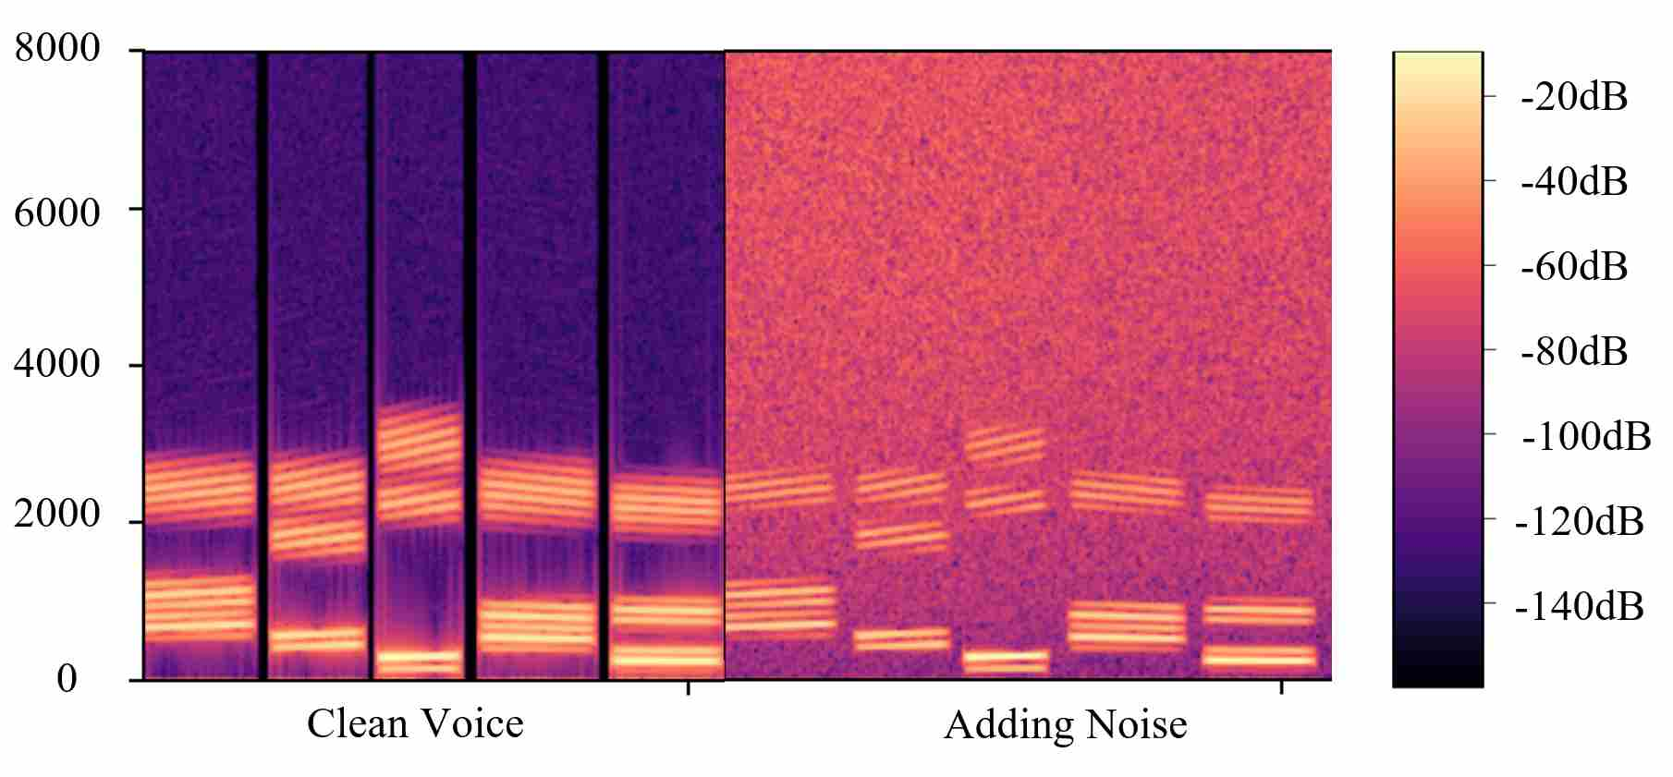
Frequency-Domain Observation
10
Low Frequency
Clean Voice
High Frequency
Hiss Noise

Slide 11
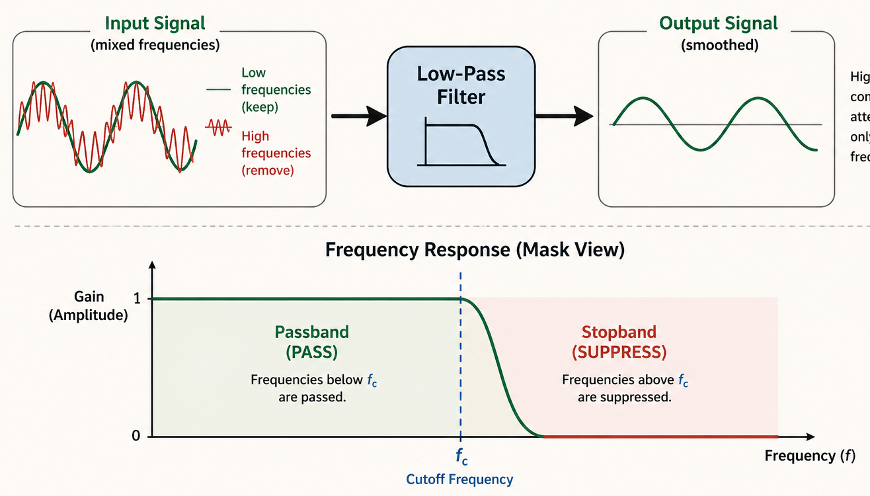
Low-Pass Filter
11
Low-pass filter keeps lower frequencies and attenuates higher frequencies.

Slide 12
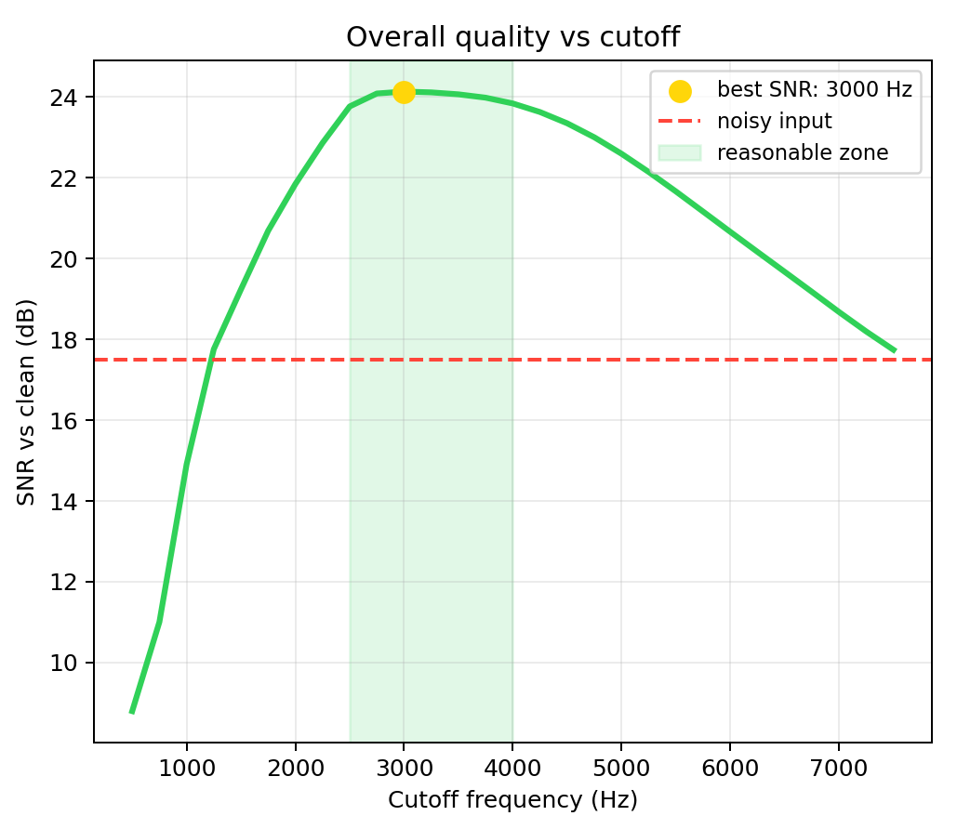
Parameter Choice
12
Lower cutoff: stronger noise reduction, but speech suffers more.
Higher cutoff: more speech detail, but more hiss remains.
Trade-off !

Slide 13
Shortage of low-pass filter
13
Low-pass uses the same attenuation for the entire signal.
It does not know the signal is speech-dominant or noise-dominant.
This can reduce hiss, but it can also remove useful speech detail.
This motivates a more flexible method.

Slide 14
03
From Fixed to Adaptive
From fixed filters to adaptive time-frequency masks

Slide 15
Frequency-Domain Masking
15
Y(f) = H(f)X(f)
Y(t,f) = M(t,f)X(t,f)
Specified gains to each frequency bin.
The mask changes with both time and frequency.
M ≈ 1
M ≈ 0
Dominated speech means little attenuation.
Dominated noise means strong reduction.

Slide 16
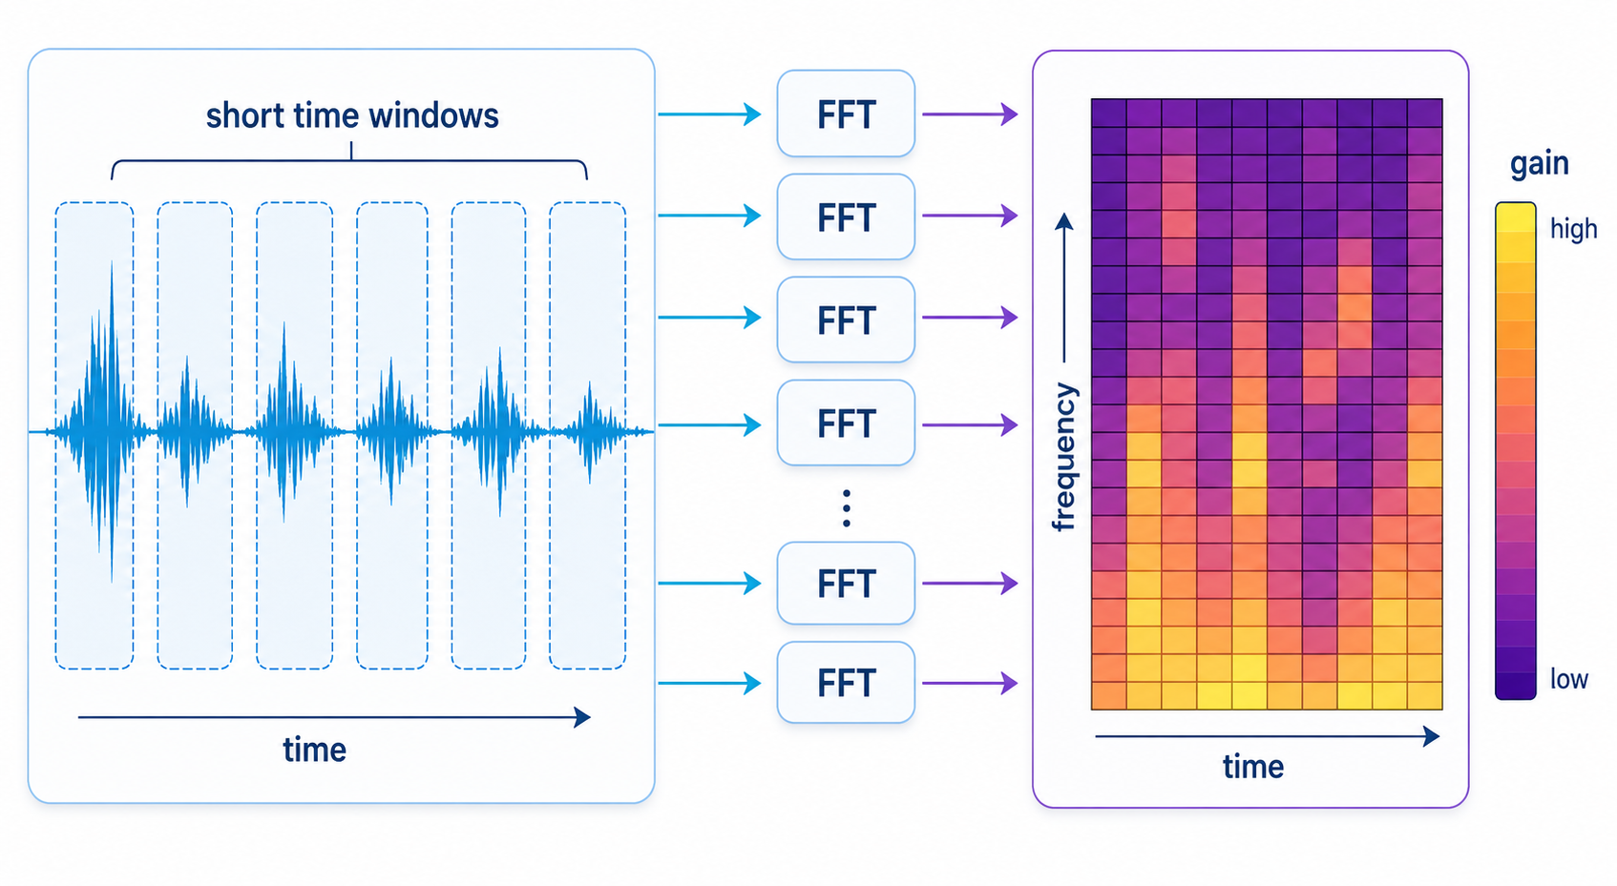
Short-time Fourier Transform
16

Slide 17
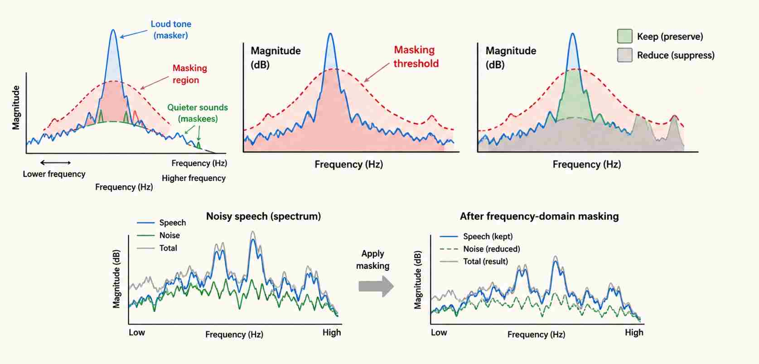
Frequency-domain mask
17
Frequency-domain masking makes local decisions and can better balance noise reduction with speech clarity.

Slide 18
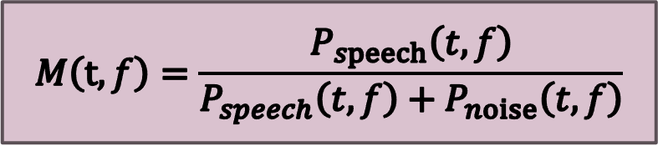
Wiener-Style Mask
18
$$M\left(t, f\right)=\frac{P_{speech}\left(t, f\right)}{P_{speech}\left(t, f\right)+P_{noise}\left(t, f\right)}$$
Adaptive Behavior
Practical Benefits
Different frequencies receive different gain values instead of using one fixed cutoff.
This often gives better clarity than simple low-pass filtering while still reducing hiss noise

Slide 19
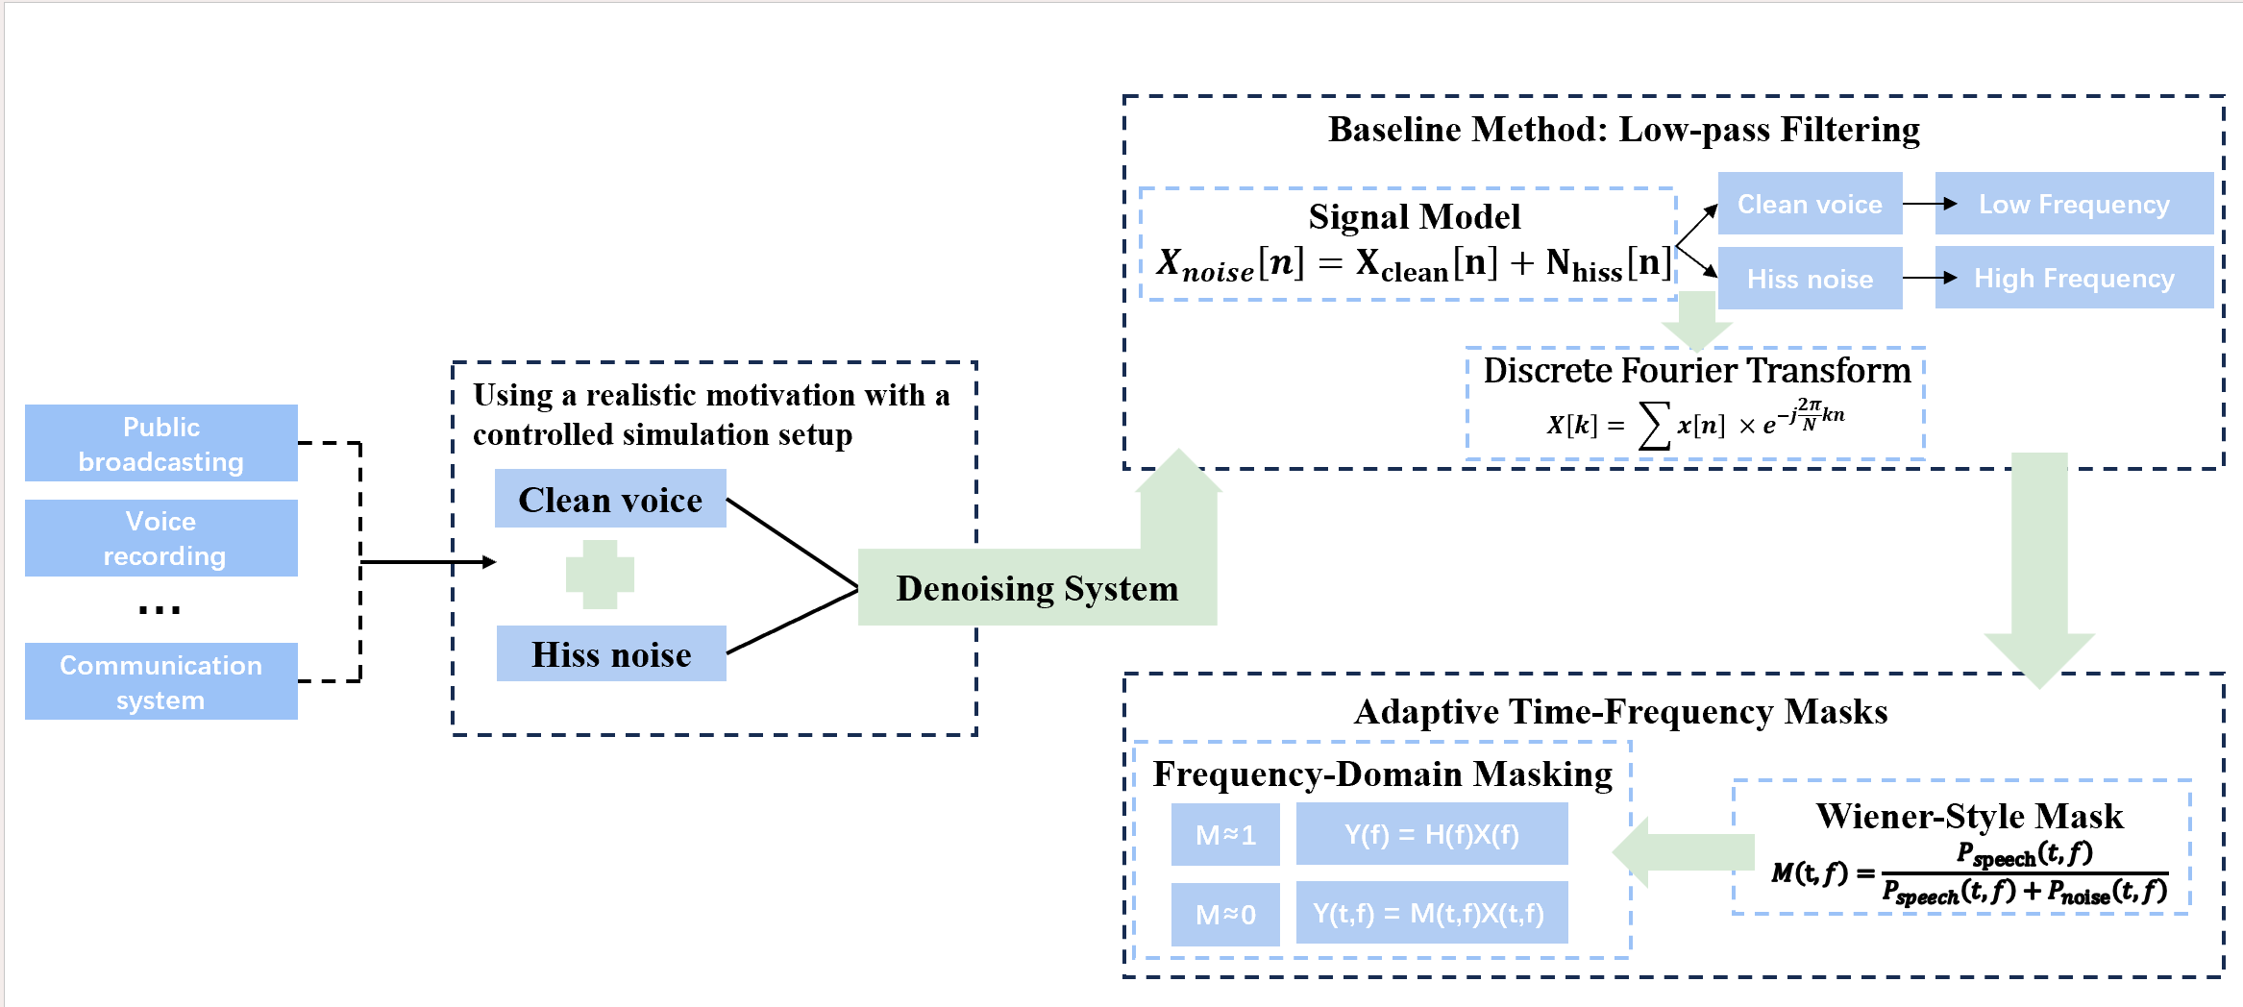
The Pipeline of Our System
19
From fixed filters to adaptive time-frequency masks

Slide 20



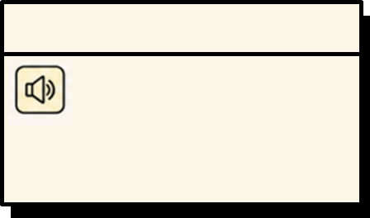


Demo
20
1. Clean voice
2. Noisy voice
- - - - - - - - - - - - - - - - - - - - - - - - - - - - - -
Reference of the original speech
- - - - - - - - - - - - - - - - - - - - - - - - - - - - - -
Speech mixed with
hiss noise
3. Low-pass result
4. Mask result
- - - - - - - - - - - - - - - - - - - - - - - - - - - - - -
After low-pass filtering:
noise reduced, but some
speech details lost
- - - - - - - - - - - - - - - - - - - - - - - - - - - - - -
After mask filtering:
noise suppressed while
speech details preserved

Slide 21
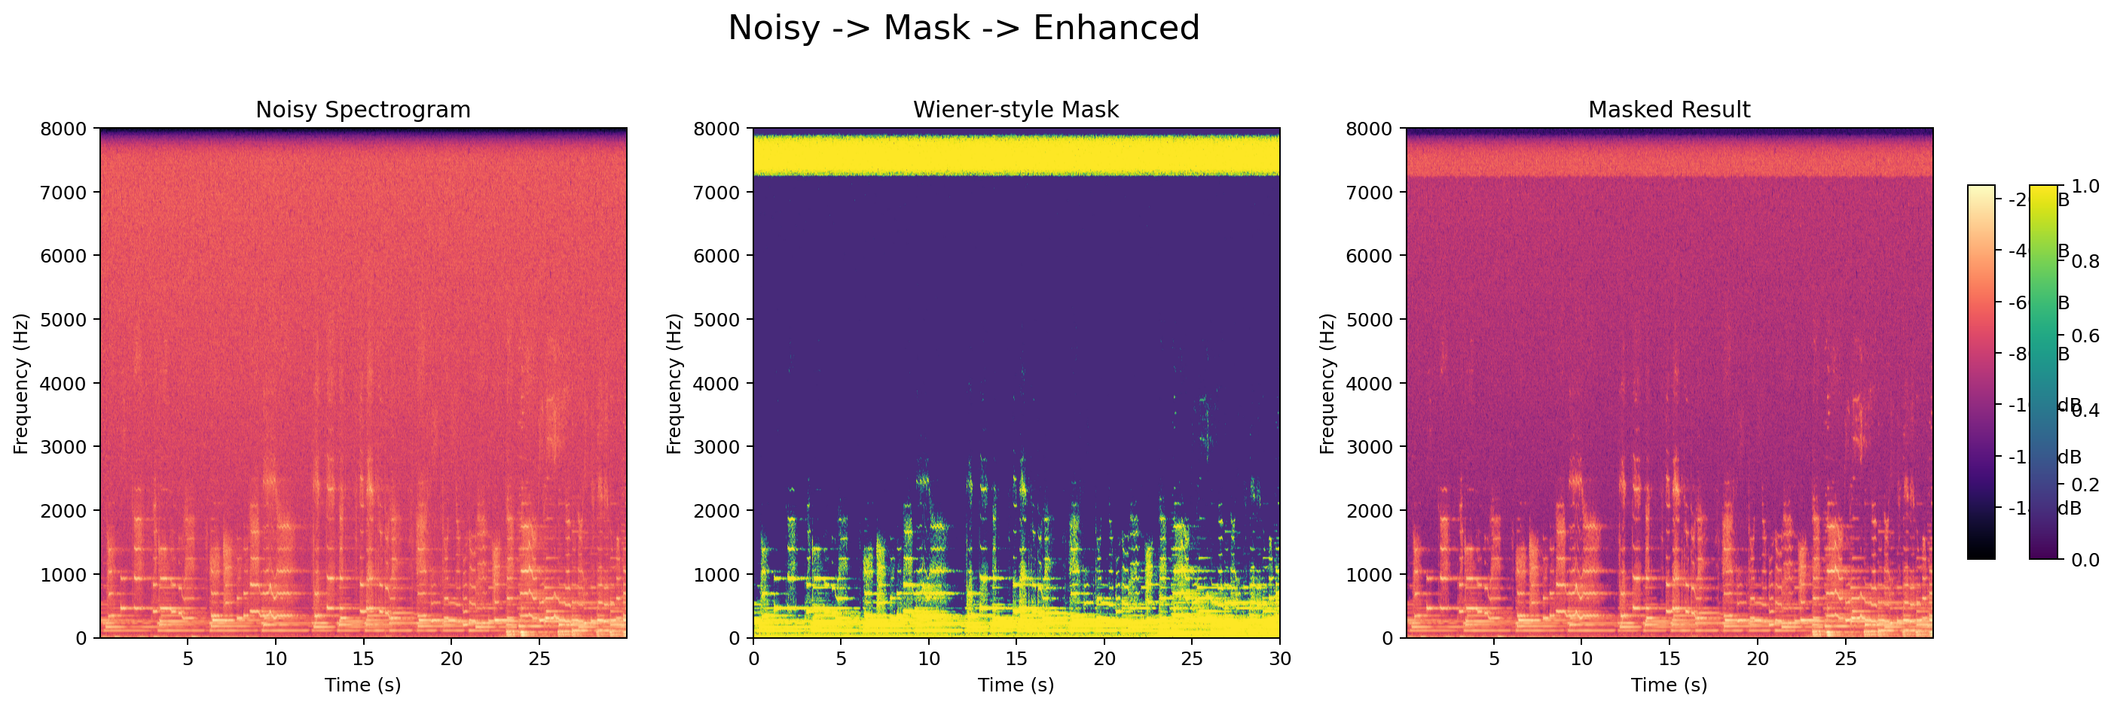
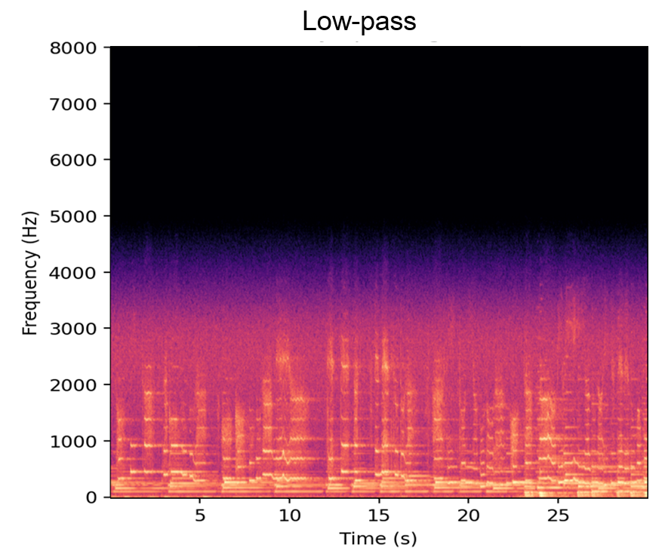
Result comparison
21
Noisy voice spectrogram
Low-pass result spectrogram
Mask result spectrogram

Slide 22
A simple filter can become a richer system
22
Conclusions
01
Signals and Systems Perspective
Modeling the voice denoising as a Signals and Systems problem.
Baseline: Low-pass Filtering
Low-pass filtering provides a simple baseline by removing
high-frequency noise.
02
03
Frequency-Domain Masking
Allowing different gains for different frequencies.
Wiener-Style Mask
Designing frequency-dependent attenuation based on the power of speech and noise.
04

Slide 23
Thanks!
Junze Xie | Ming Chen | Zifan Xu
Yimin Chen | Wanting Luo

